Slide 1
Connecting the East Orlando Communities
Overview of ATCMTD Proposal
June XX, 2017
XX, Orlando, FL

Slide 2



Advanced Transportation and Congestion Management
Technologies Deployment (ATCMTD)
$8M in 2016
$40M in 2016
ATCMTD
$60M/year from 2016-2020
GRANT APPROACH PROGRAMS LEVERAGE Q&A
Notes:
This grant is so techy that it didn’t even get a logo :D
5 Year Program in Year 2

Slide 3
ATCMTD by the Numbers
5-10 awards of up to $12M
$60M
GRANT APPROACH PROGRAMS LEVERAGE Q&A

Slide 4
ATCMTD by the Numbers
50% Match
GRANT APPROACH PROGRAMS LEVERAGE Q&A

Slide 5
Approach
GRANT APPROACH PROGRAMS LEVERAGE Q&A

Slide 6



Collaborative Effort
In Partnership with:
District Five
GRANT APPROACH PROGRAMS LEVERAGE Q&A

Slide 7
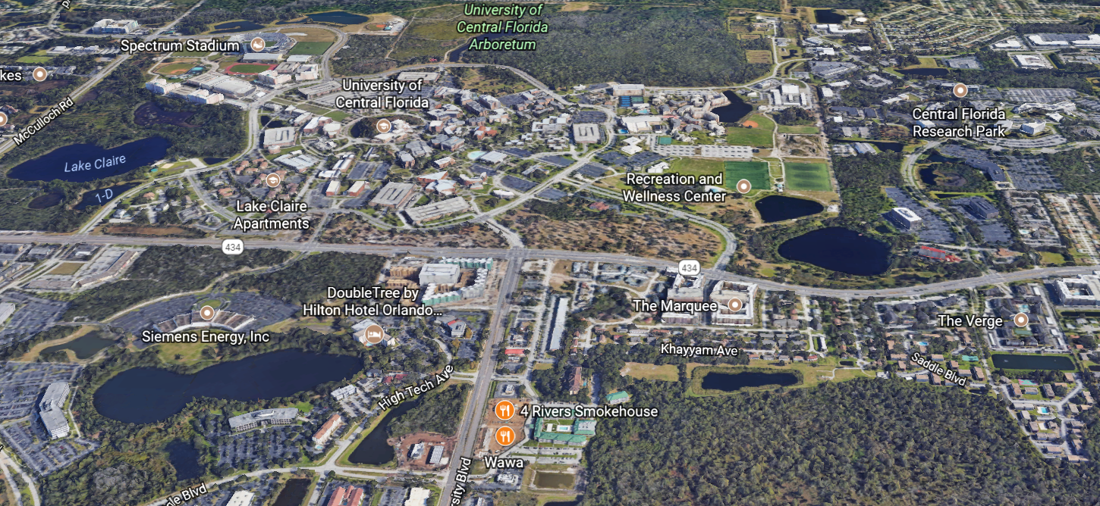


Community Driven
GRANT APPROACH PROGRAMS LEVERAGE Q&A
Notes:
Mention “wow” statistics:
UCF currently has the second highest number of enrolled students in the U.S., with more than 64,000 students.
Immediately abutting UCF, the CFRP is the largest research park in Florida, home to more than 10,000 employees in over 100 companies.
East Orlando as a geographic focus area, inspiring the name change. Aligns with Smart Cities and with goal to frame this as helping a community.

Slide 8
Needs Driven
Proposal highlighted needs of East Orlando
  Connecting people through different modes
  Improving pedestrian safety
  Managing congestion
  Ensuring timely transfers
  Making smart, sustainable improvements
  Understanding risks and benefits of emerging technology
GRANT APPROACH PROGRAMS LEVERAGE Q&A

Slide 9

Integration Driven
ATCMTD Focus Areas | Existing Program | Proposed Programs
 | SunStore | PedSafe | GreenWay | SmartCommunity
Multimodal Integrated Corridor Management (ICM)
CV Tech at Intersections and Ped Crossings
Freight Community System
Tech to Support Connected Communities
Infrastructure Assessment
Rural Technology Deployments
GRANT APPROACH PROGRAMS LEVERAGE Q&A

Slide 10
Programs
GRANT APPROACH PROGRAMS LEVERAGE Q&A

Slide 11

PedSafe
Leverages advanced signal controller capability and Connected Vehicle (CV) technologies
Likely to build off work from THEA/University of Arizona
  Wayfinding for persons with sight disabilities
  Enhanced GPS version due out later this year
  LIDAR at intersection for detection of conflicts
  One way communication of alerts with DSRC, cellular, and Wi-Fi
GRANT APPROACH PROGRAMS LEVERAGE Q&A
Notes:
Not specific on Technology

Slide 12
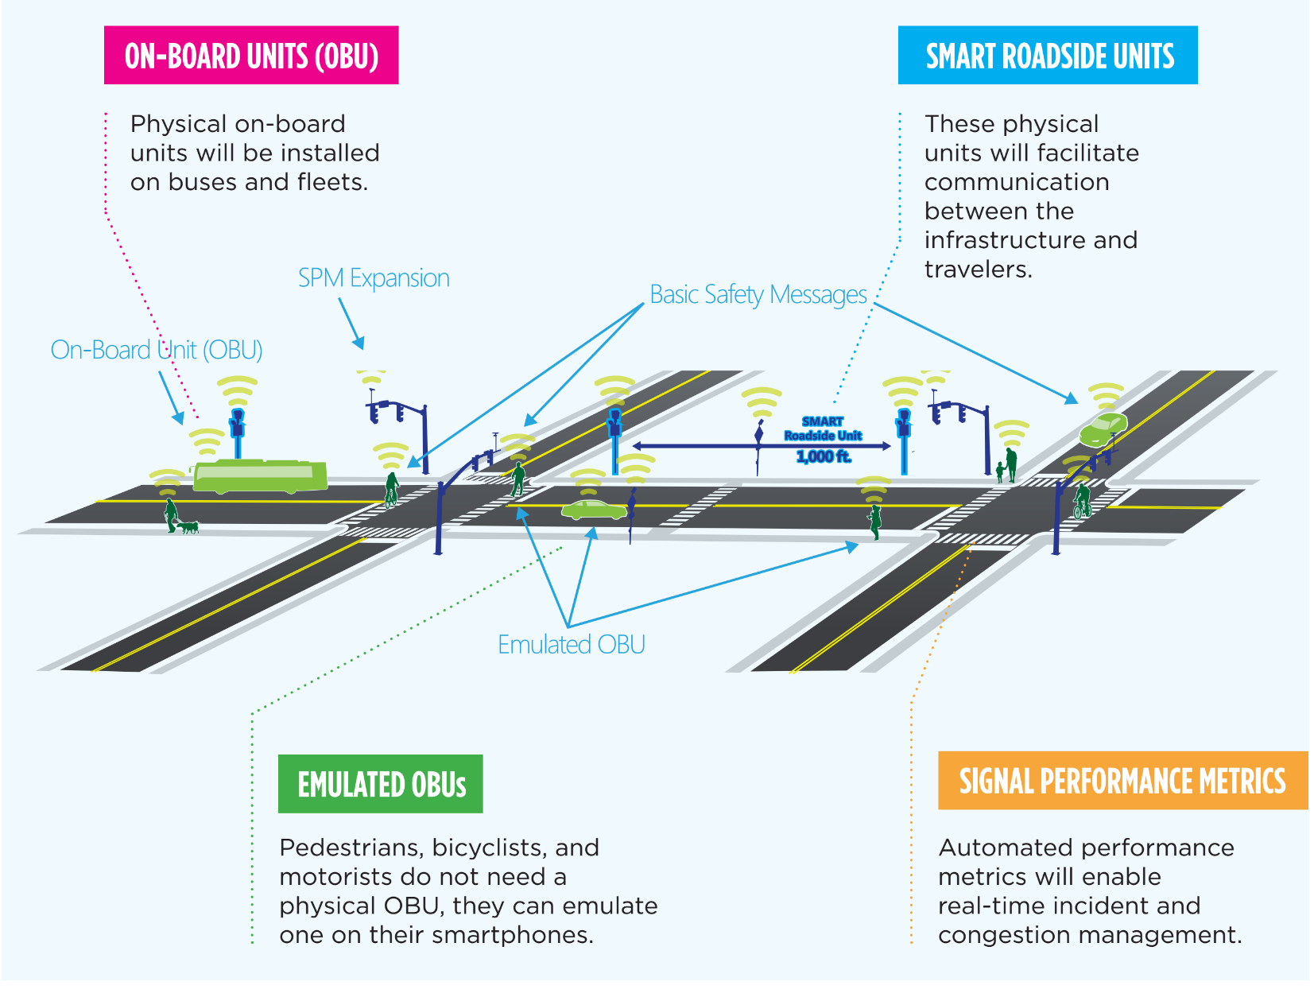

GRANT APPROACH PROGRAMS LEVERAGE Q&A

Slide 13
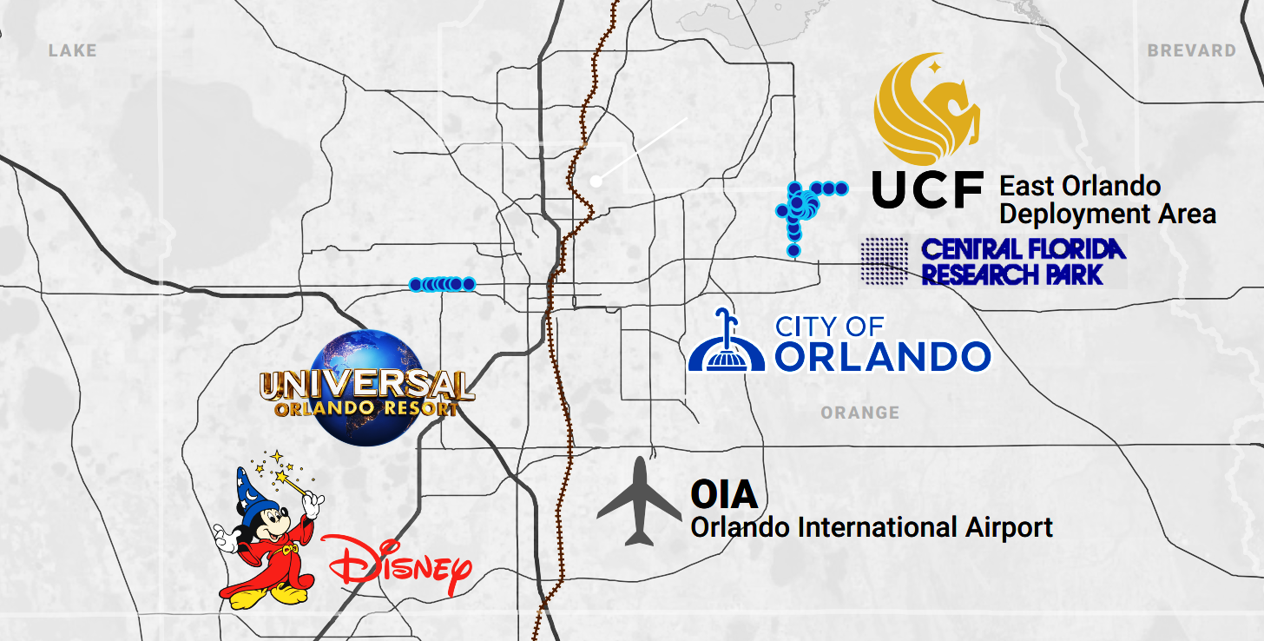
UCF Area
Pine Hills
GRANT APPROACH PROGRAMS LEVERAGE Q&A
Notes:
Waiting on new map

Slide 14
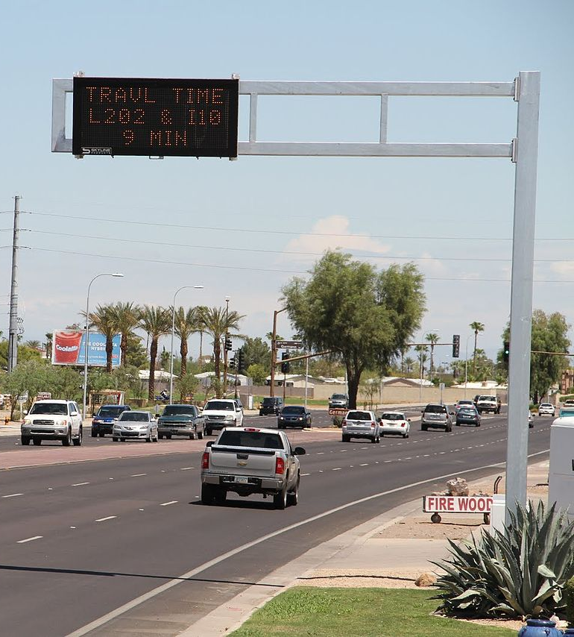
GreenWay
Multimodal Integrated Corridor Management
Real-time traffic signal analytics and control
Adaptive Traffic Signal Interface with Track Positive Train Control
Conditional Transit Signal Priority
GRANT APPROACH PROGRAMS LEVERAGE Q&A

Slide 15
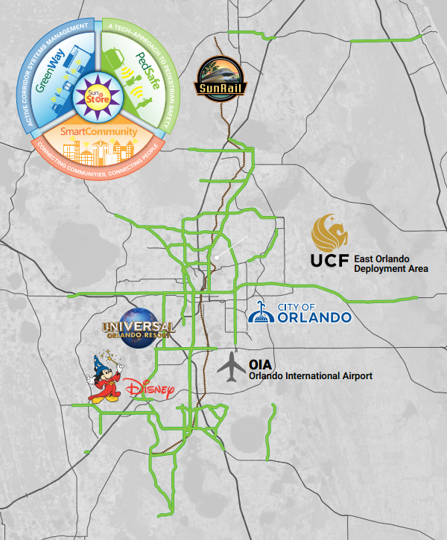

Scalability and Portability
Manage major corridors throughout the District
Inside and outside of
MetroPlan Orlando
GRANT APPROACH PROGRAMS LEVERAGE Q&A
Notes:
Waiting on new map

Slide 16
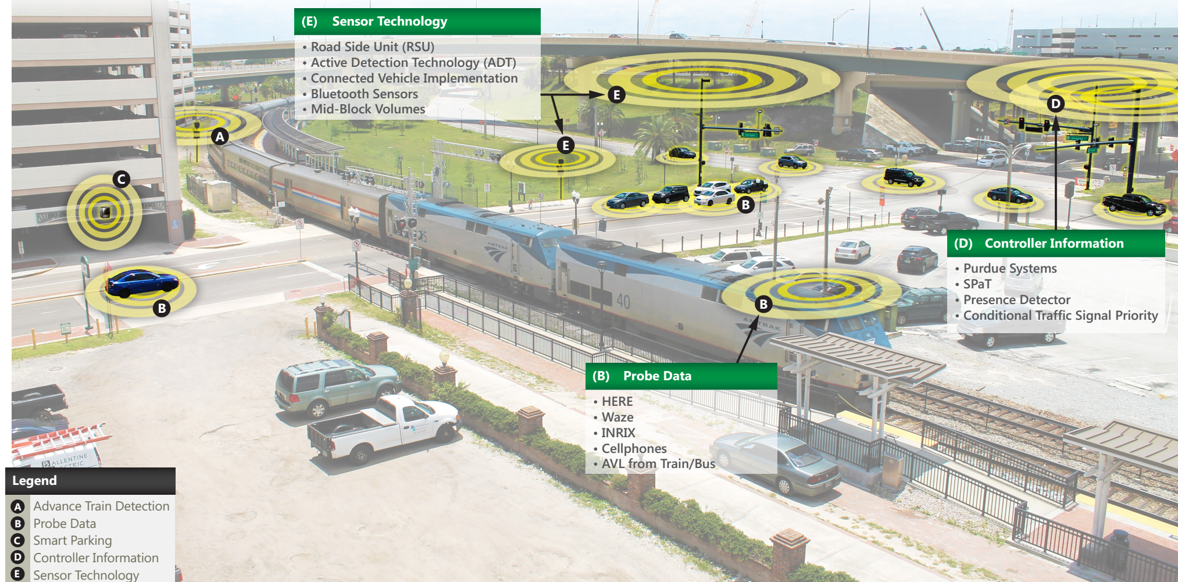

Latest and Greatest Roadside Technology
GRANT APPROACH PROGRAMS LEVERAGE Q&A
Notes:
Adaptive Signal Control
Signal Performance Metrics
Intersection Movement Counts
Connected Vehicle
Smart Parking

Slide 17
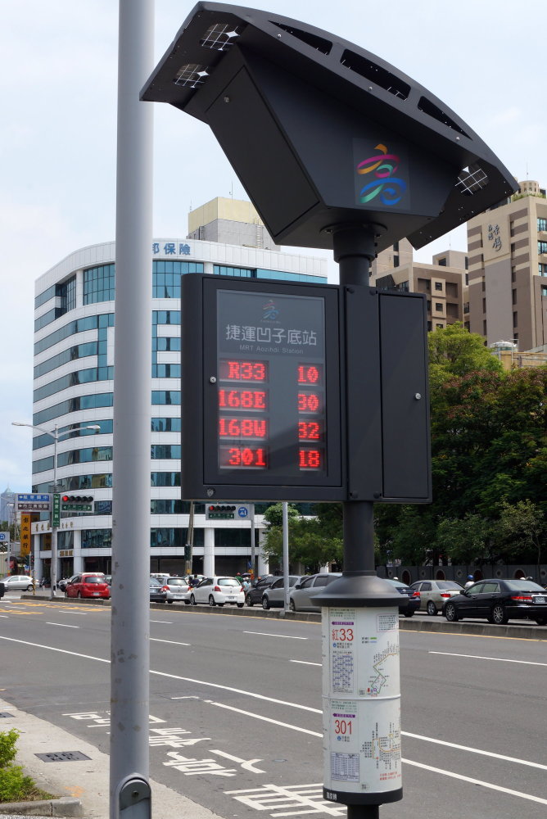
SmartCommunity
Leveraging Aspects of Smart Cities
Developing Mobility on Demand (MoD) framework
Trying to pave way for Mobility as a Service (MaaS)
GRANT APPROACH PROGRAMS LEVERAGE Q&A

Slide 18

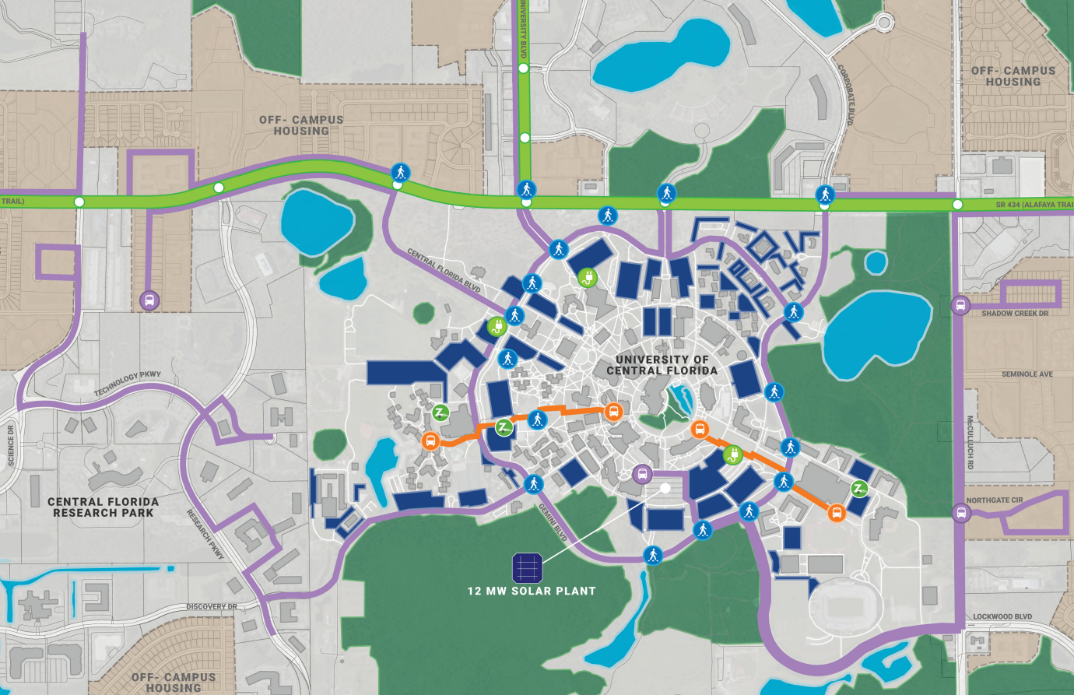
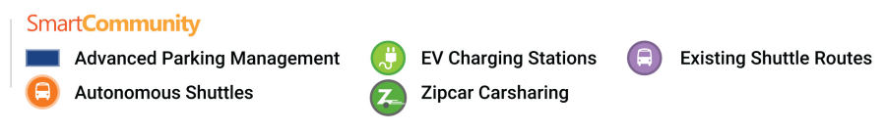
GRANT APPROACH PROGRAMS LEVERAGE Q&A
Notes:
SmartCommunity
-UCF Campus
-Later scalable to Downtown Orlando

Slide 19
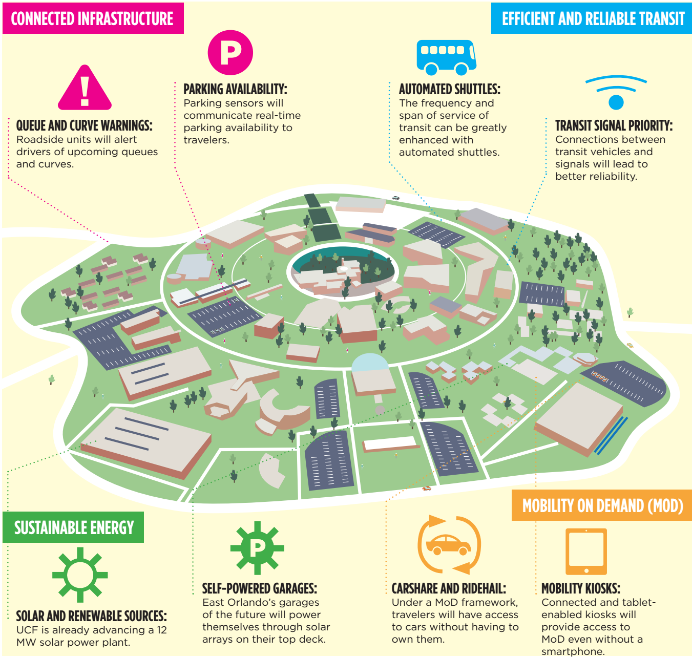
Latest and Greatest
Smart Cities Technology
Transit Kiosk
Connected Vehicle Technology
  Safety and Mobility Applications
Autonomous Vehicles
Solar Energy
Real-Time Multimodal Data
  Bus Automated Vehicle Location
  Parking Availability
  Travel Times
  Ride Share Availability
  Transit Demand
GRANT APPROACH PROGRAMS LEVERAGE Q&A

Slide 20
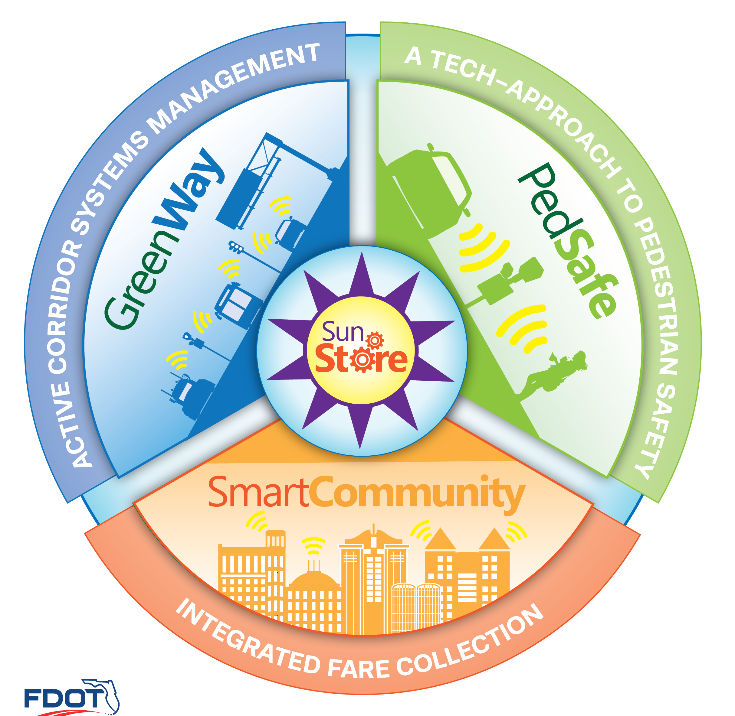
SunStore
Engine the makes everything work
Performance Management
Keeping everyone on same page
Latest and Greatest Technology for Data Management
GRANT APPROACH PROGRAMS LEVERAGE Q&A
Notes:
Big Data Store
Data Lake Concept
Allow Future Growth
Machine Learning
Artificial Intelligence

Slide 21
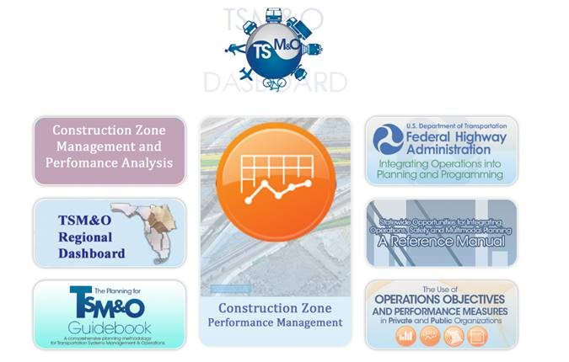
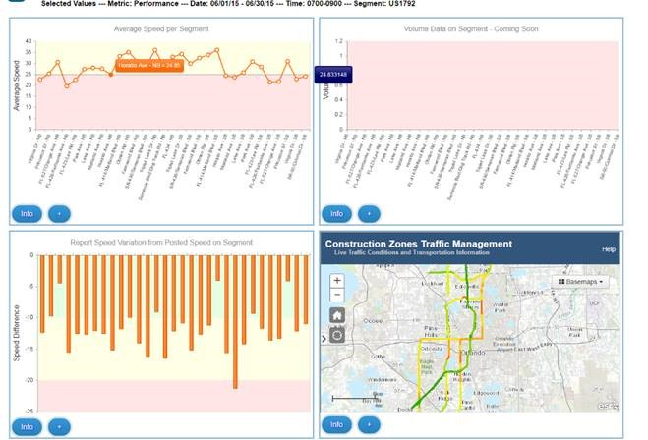
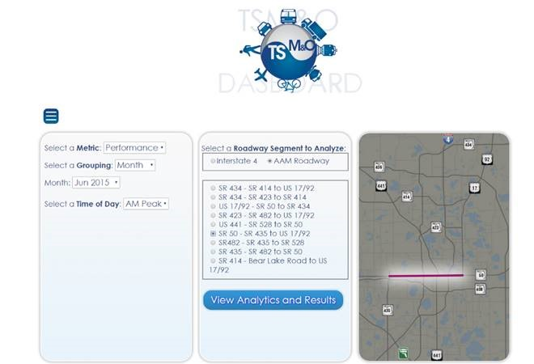
Planning Dashboards
GRANT APPROACH PROGRAMS LEVERAGE Q&A

Slide 22
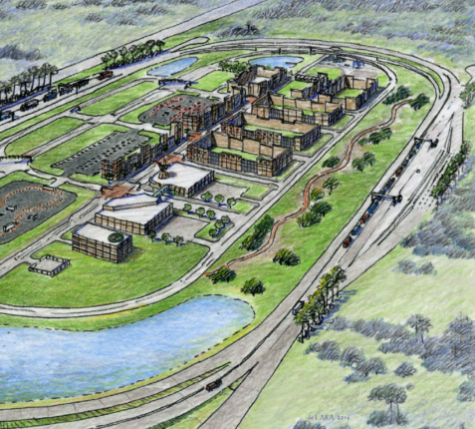
Synergies
Central Florida Automated Vehicle Partners
Tampa CV Pilot
Smart City Council Designation
GRANT APPROACH PROGRAMS LEVERAGE Q&A

Slide 23
Questions and Answers
Continue to invest in O&M
  Improve security by complying with standards
  Implementing Standard Configuration of Devices
  Continue establishment domain trusts, BGP, and IP scheme
  Repairing end devices (detectors, cameras, and sensors)
Continue effort to share resources
  Software
  Data Sharing
  Fiber
GRANT APPROACH PROGRAMS LEVERAGE Q&A

Slide 24
Questions?
GRANT APPROACH PROGRAMS LEVERAGE Q&A

