Slide 1

FDOT’s Connected
Vehicle Evaluation

Slide 2
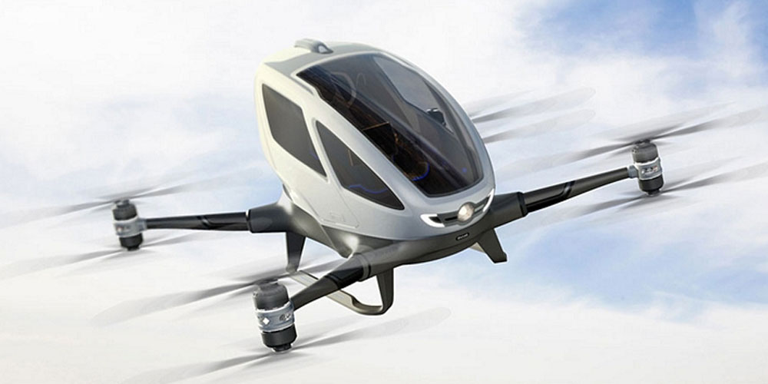

Connected and Autonomous Vehicles
When do I get my flying car?
Connected and Autonomous Vehicles are on our Roads TODAY

Slide 3
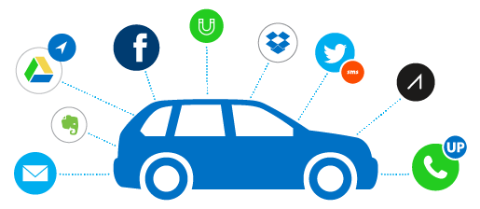
Connected Vehicle(CV)
Connected Vehicle
What are Connected Vehicles?
  V2V
  V2I
  V2X

Slide 4

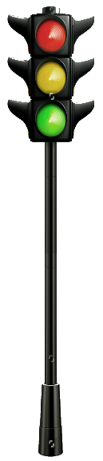






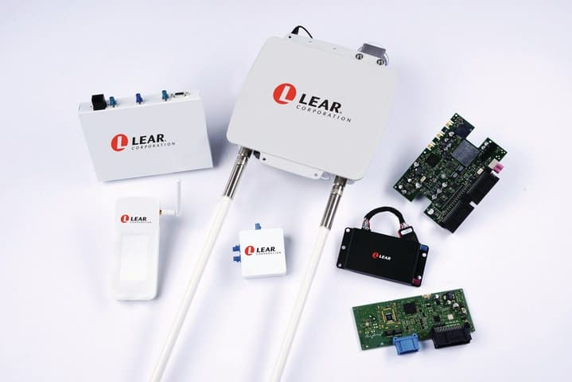



Connected Vehicle Components
4

Slide 5
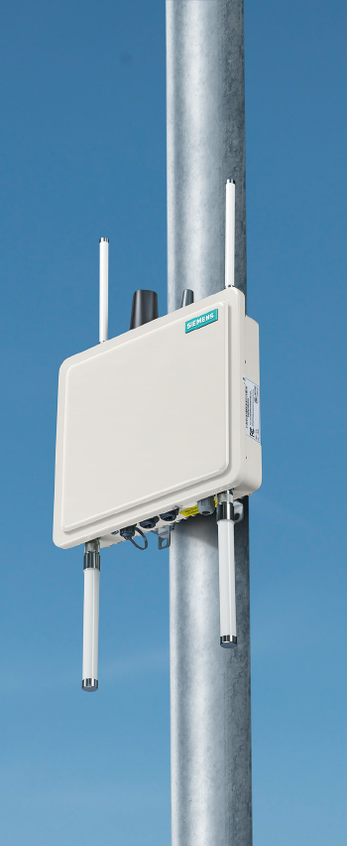
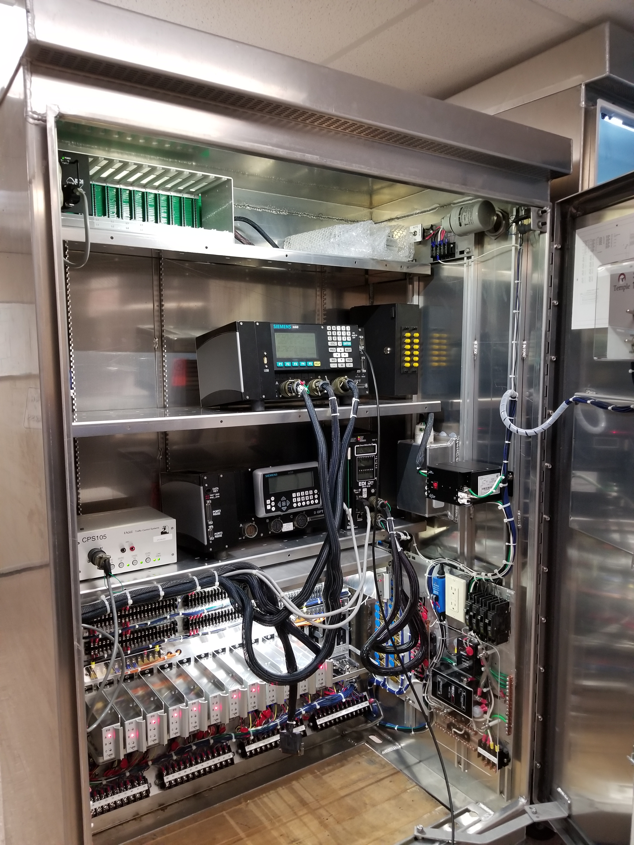
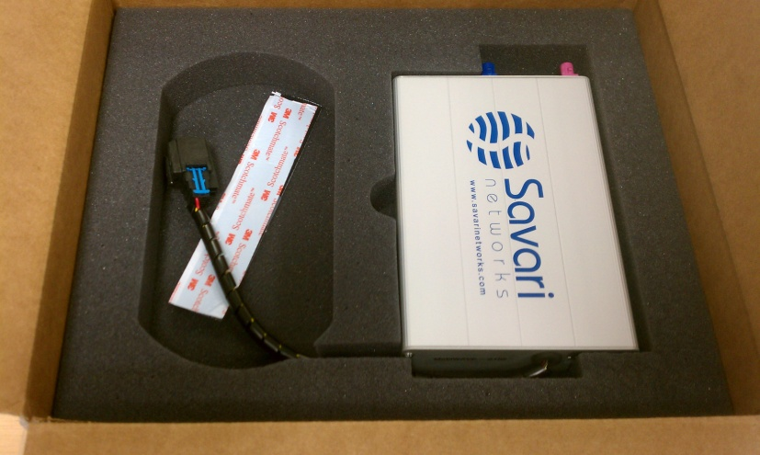
Connected Vehicle Components
Controllers
  What it is and what it does?
  Switch
RSU
  What it is and what it does?
  Manufacturers
OBU
  What it is and what it does?
  Manufacturer
  SAE standards

Slide 6
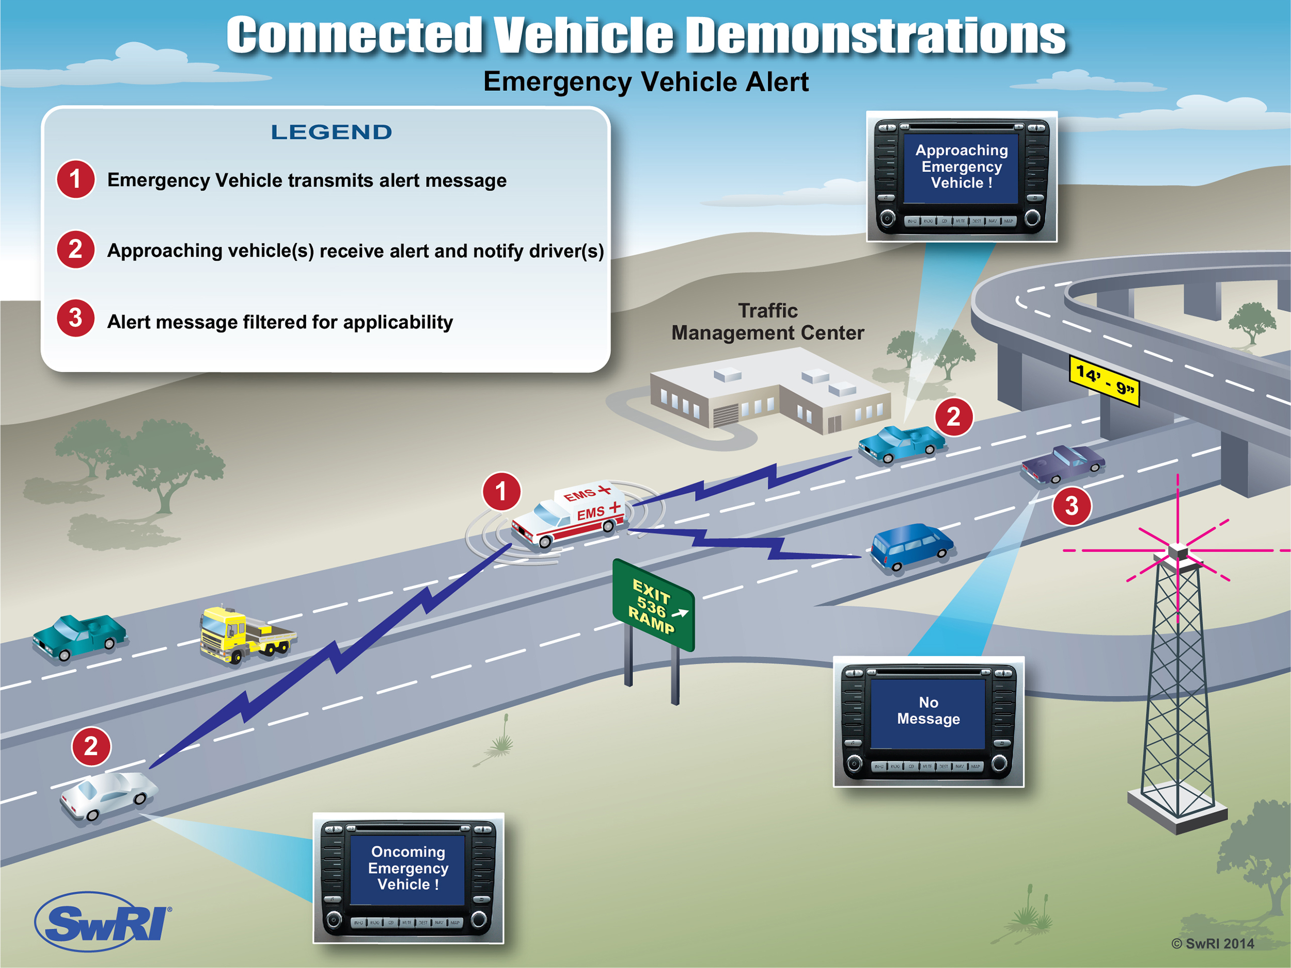
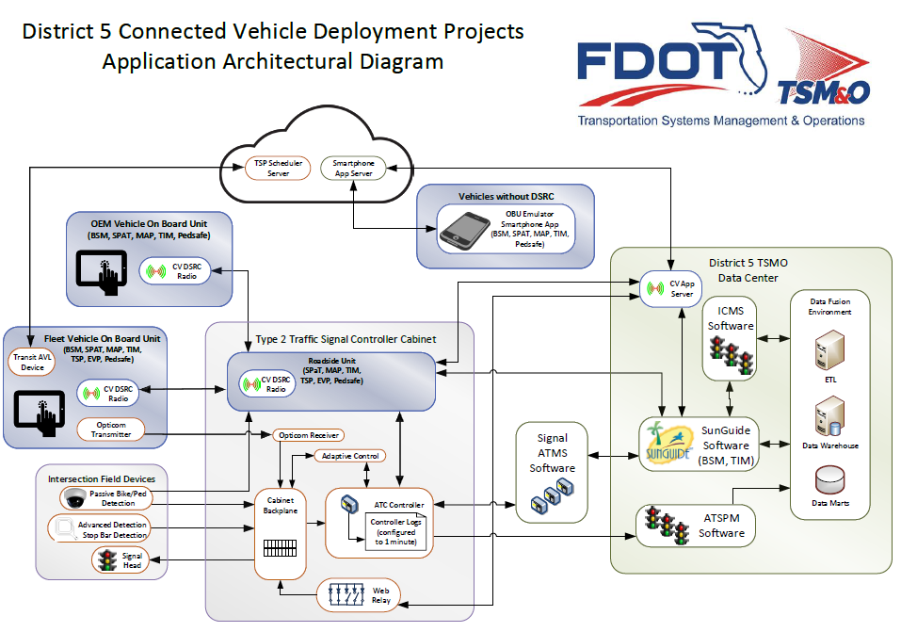
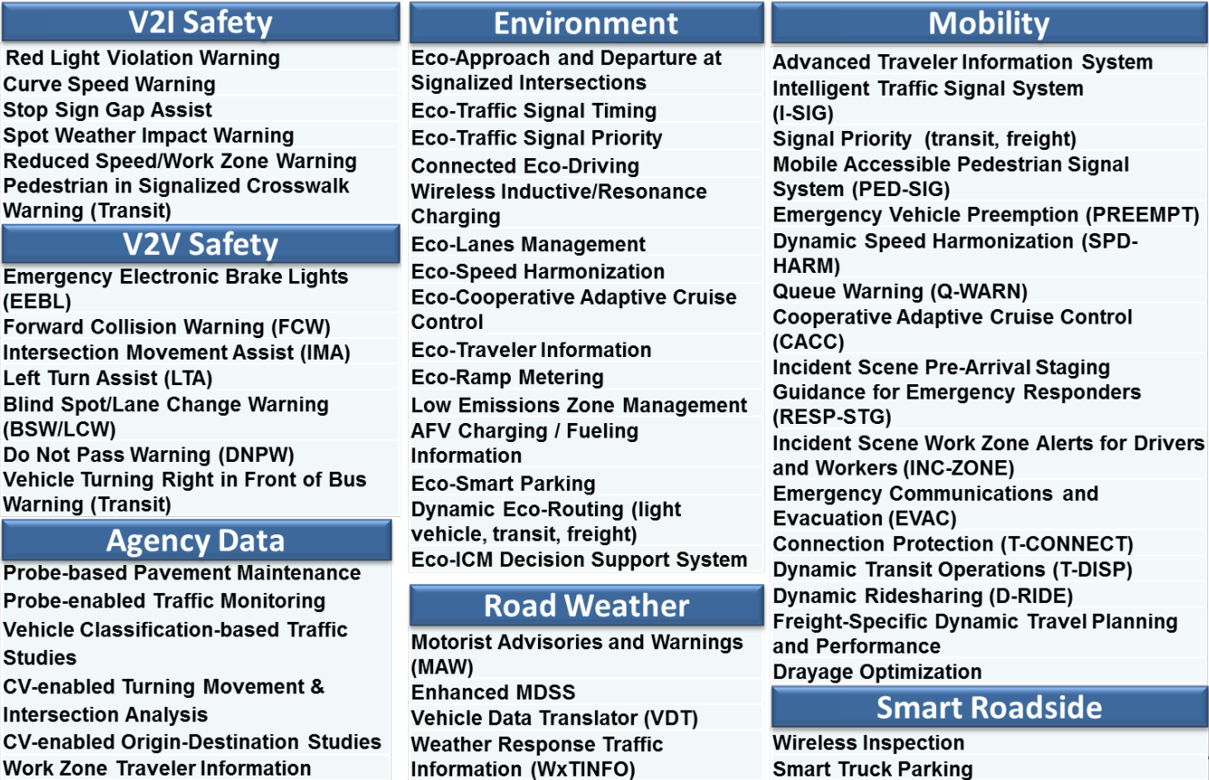

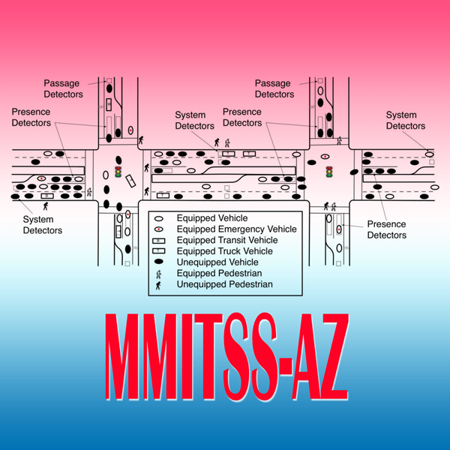
Connected Vehicle Applications
CV applications
  What are the applications?
    SPaT
    TSP
    EVP
  Where to find the applications
    ITS Forge - Open Source Applications?
    CV Pilot Projects
Welcome to Reality!
Why we need to Evaluate/TEST?
  Communication between devices
  Compatibility w/ existing Infrastructure
  Applications
Counties/Cities
Manufacturers
Partnerships
Security Credentials

Slide 7
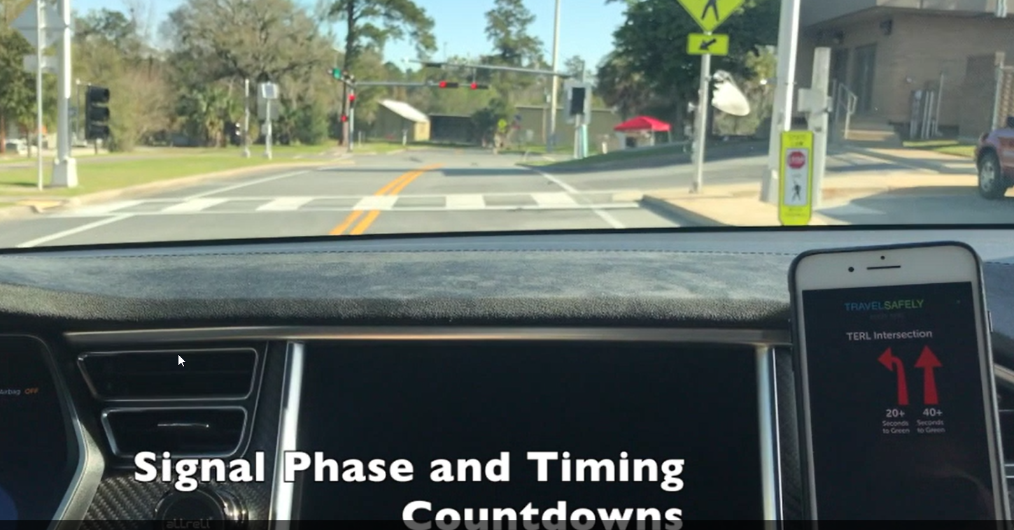

CV Evaluation
3 Phases
  Signal Shop
  TERL
  In Site
What are we evaluating?
  Controller/ RSU scenarios
  Transmitted and Receive packages
  Applications per RSU
    SDKs - proprietary
Get our house in order
  Connections
  Security - SCMS
  Coordinate with Central Office and THEA Connected Vehicle testbed lessons learned
  Worked with vendors and Counties to develop smart signals

Slide 8
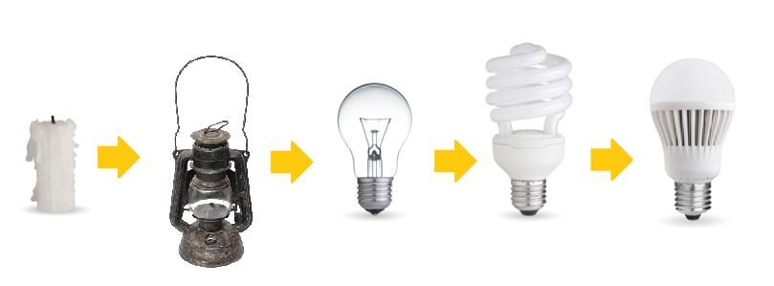
D5 Connected Vehicle Projects
Projects:
  I-75 FRAME
  PedSafe/GreenWay Deployment
  CV Pilot on SR 434
Why we are using this technology?
  Technology don’t dictate needs
  Needs dictate Technology
    Safety
    Mobility
    Environment
    Weather

Slide 9
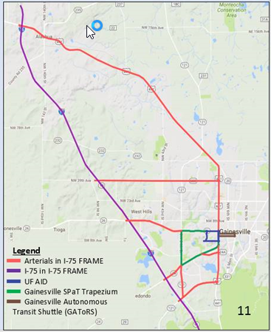
I-75 FRAME - Florida’s Regional Advanced Mobility Elements
I-75 FRAME
  D-2 Gainesville
  D-5 Ocala
Purpose: Provide CV technology along connecting corridors between I-75 and US 301/441
Technology:
  Advance Signal Controllers
  Connected Vehicle Technology
    SPaT
    EVP
    TSP

Slide 10
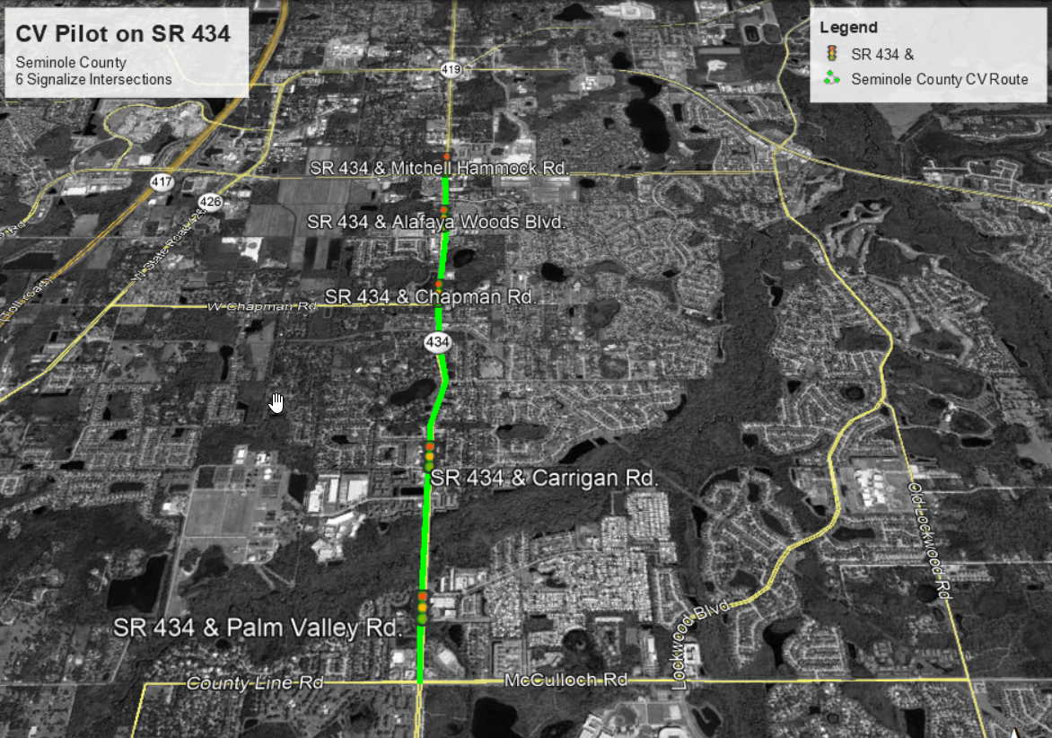
CV Pilot at SR 434
CV Pilot
  SR 434 North of UCF
  First phase
  of UCF deployment
  Student Housing along
  Technology
    CV
    Applications:
    Spat
    TSP
    EVP

Slide 11
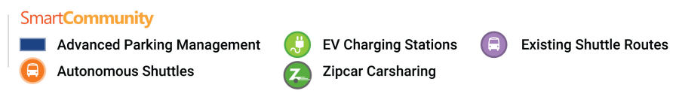
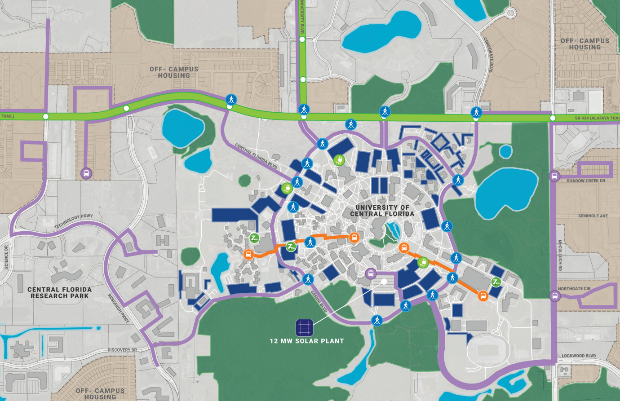
PedSafe/GreenWay Deployment
PedSafe/GreenWay
  UCF
    PedSafe
    Transit Verification System
    Parking Availability System
    AV Shuttle
  DW Location
    Greenway
Notes:
This project is divided in two portions: PedSafe and Greenway
UCF area include the Pedsafe portion
Pedsafe
Purpose
Location
Technology
Transit Verification System
CCTV
Transit Kiosk
Parking Availability System
CCTV
Flat Lot Parking
AV Shuttle
Routes

Slide 12
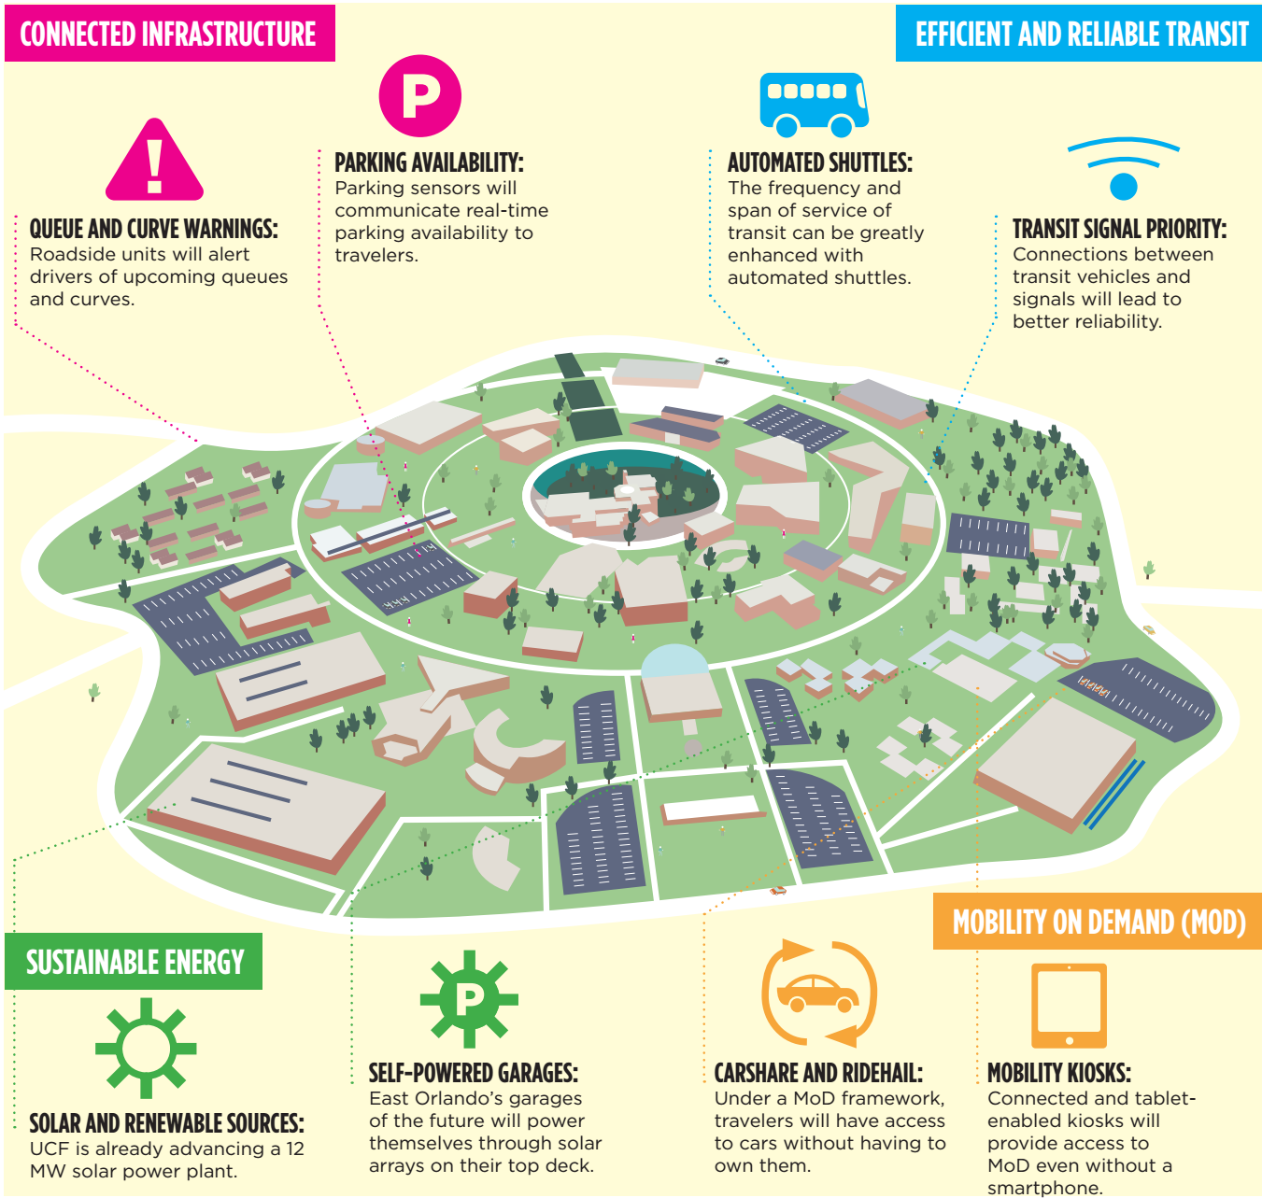
Ped Safe (UCF Area)
Transit Kiosk
Connected Vehicle Technology
  Safety and Mobility Applications
Autonomous Vehicles
Solar Energy
Real-Time Multimodal Data
  Bus Automated Vehicle Location
  Parking Availability
  Travel Times
  Ride Share Availability
  Transit Demand

Slide 13
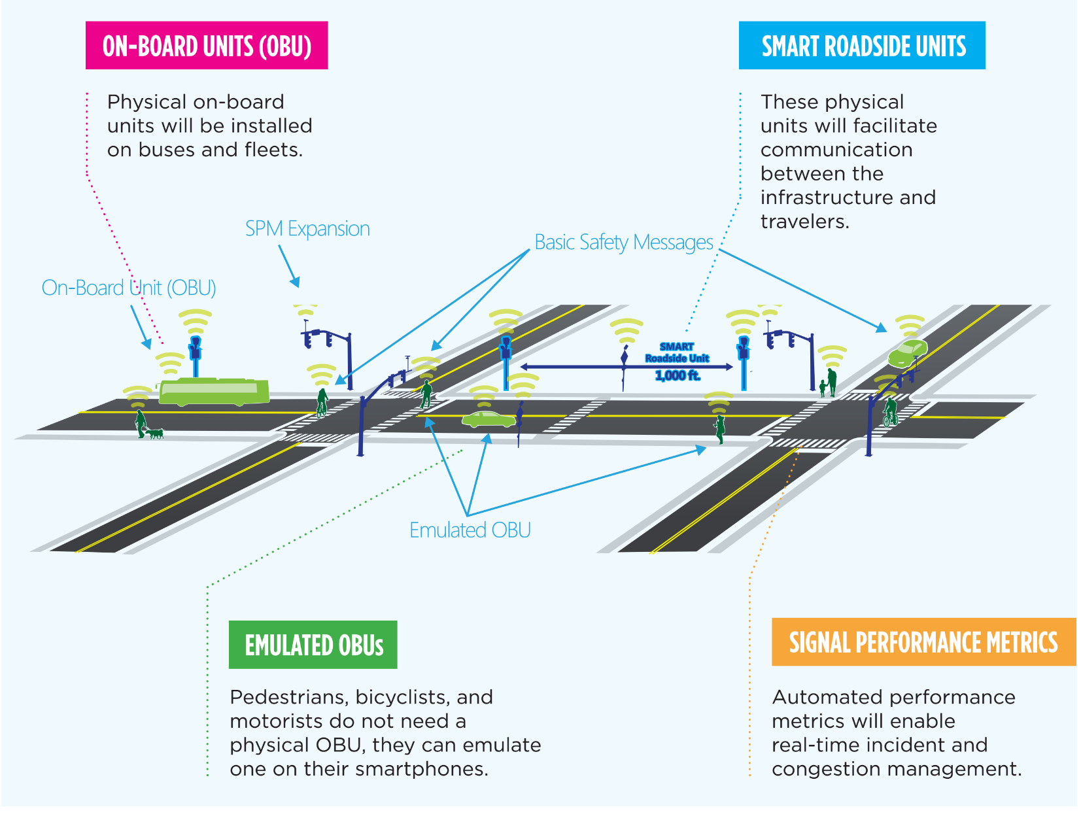


Slide 14
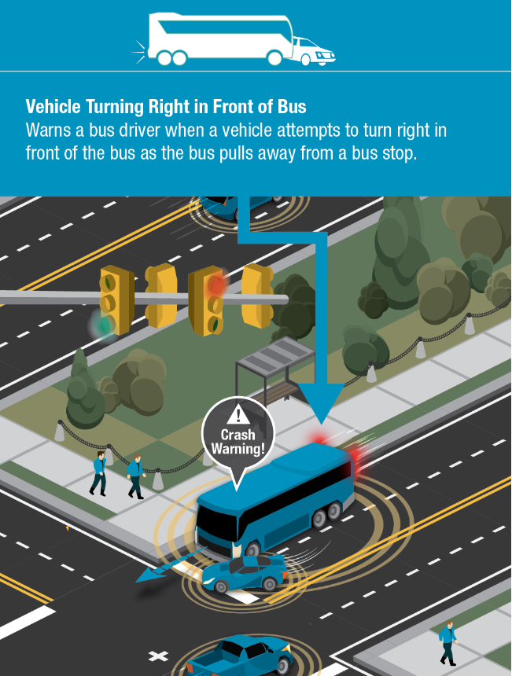
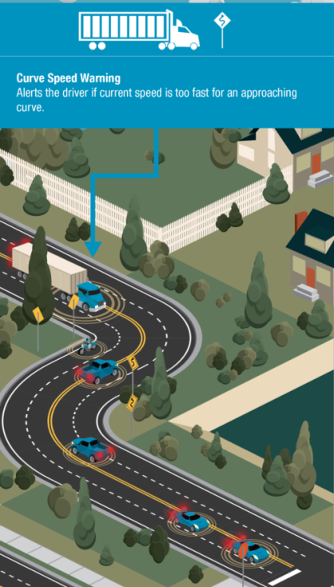
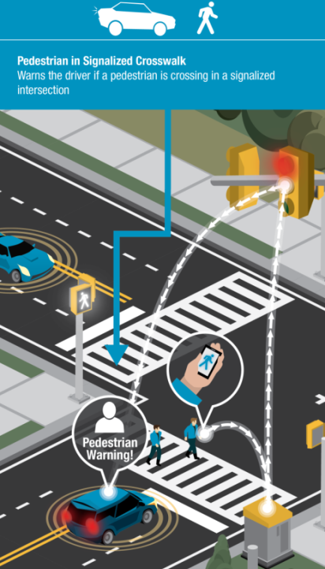
Applications
Right Turn in front of Vehicle
Curve Speed Warning
Ped. in Signalized Intersection
Applications
  SPaT
  TSP
  EVP
Additional applications on the UCF area

Slide 15
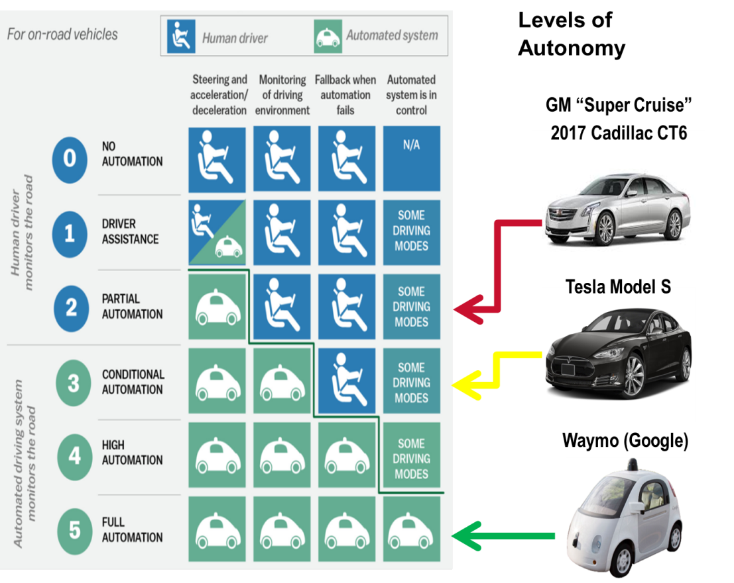
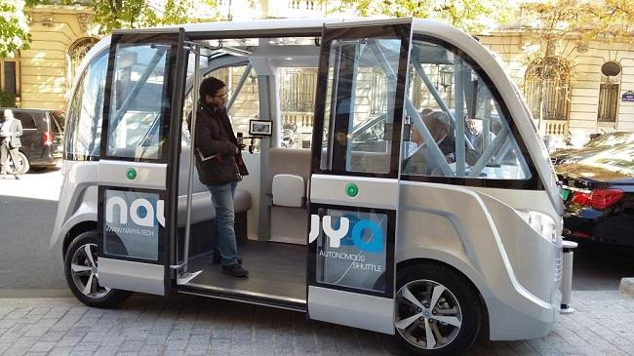
Autonomous Vehicle(AV)
Autonomous Vehicle
What are Autonomous Vehicles?

Slide 16
So what am I going to see
In test lab
  Controller mock up
  Connected Vehicle Units
Outcome
  Specifications
  Standard Drawings
  Compatibility Matrix
Next Step Deployment
  Autonomous Vehicle by end calendar year
  Letting February, Construction until 2021

Slide 17
What did we learn today
Rides
  You aren’t getting one today
  But you will be next year
5 levels of autonomous vehicle
OBU and RSU
  Need both; it may be a while on the OBU
  Cell Phone for emulated OBU for early deployment
Nothing works right, right now
  Applications and RSU to controller need testing
How project development is changing
  Compatibility ➔ applications and hardware need to be known
  Specification
  Standards

Slide 18

Questions?

