Slide 1
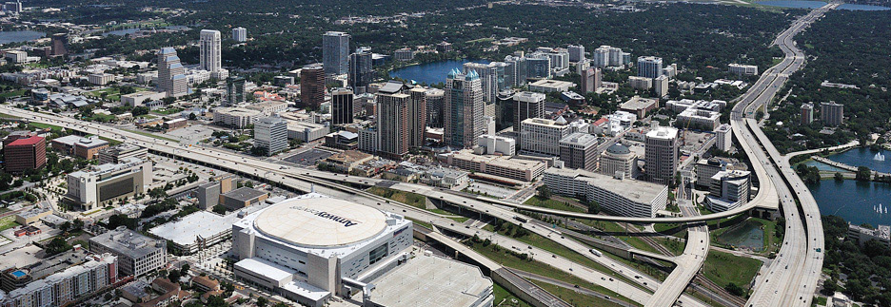
Florida DOT – District 5: Big Data and Decision Support for an Integrated Corridor Management System

Slide 2
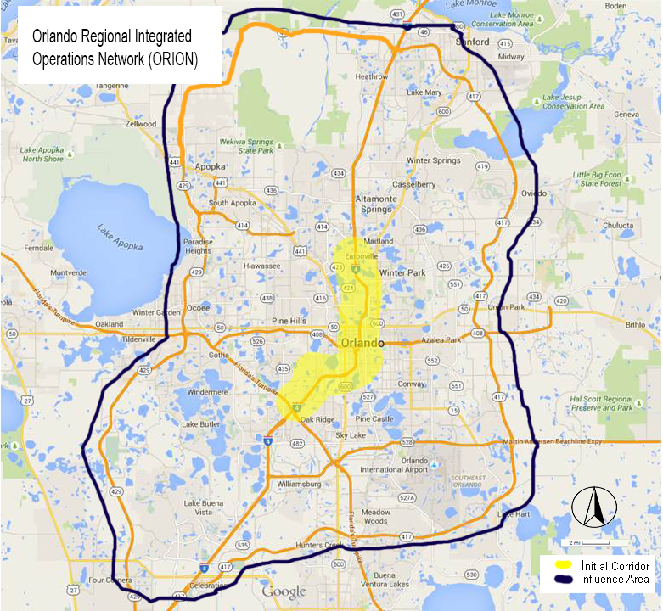
FDOT D5 – Integrated Corridor Management Program
Orlando, FL region
  FDOT (Freeways and Active Arterial Mgmt)
  MetroPlan (MPO)
  2 Toll Authorities (FTE, CFX)
  LYNX (Bus)
  SunRail (Commuter Rail)
  3 County Signal Systems (Orange, Seminole, Osceola)
  4 Cities (Orlando, Winter Park, Maitland, Kissimmee)
January 2017

Slide 3
Corridor Assets
Transportation Facility (With Corresponding Agency(ies)) within the Orlando region | Summary Total
Transportation Management Centers | 8 TMCs (FDOT/CFX, City of Orlando, Orange County, Seminole County, Osceola County, LYNX, SunRail, FTE)
Commuter Rail Transit System | 61.5 miles (SunRail)
Bus Transit System | 63 Routes (LYNX)
Computer Controlled Traffic Signal Systems
Seminole County (TrafficWare) | 380 signalized intersections
Orange County (Siemens) | 600 signalized intersections
Osceola County (Econolite) | 177 signalized intersections
City of Orlando (TrafficWare) | 500 signalized intersections
Park and Ride Lots | 12 SunRail Stations
Interstate Highway (I-4) | ~ 72 miles (FDOT), 21 miles of express lanes
Toll Roads | ~ 55 miles (Florida Turnpike) ~ 109 miles(CFX)
January 2017

Slide 4
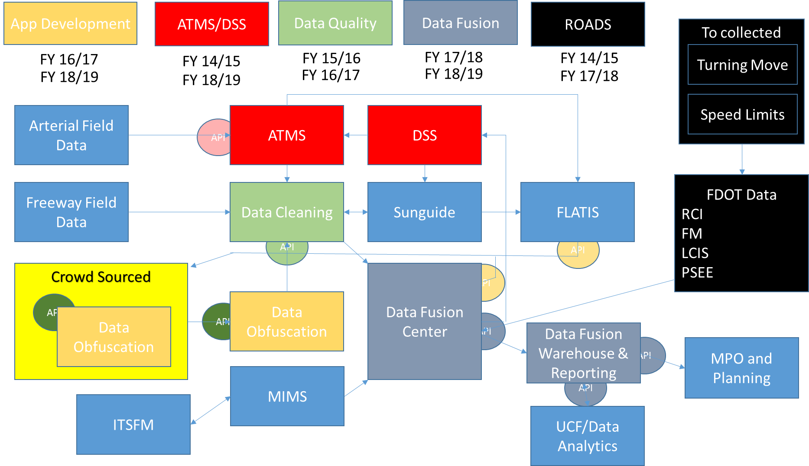
FDOT D5 - Approach
Multi-Year / Multi-Project Approach for TSM&O within the District
  Data Fusion and Analytics
  Data Quality
  Decision Support
  Active Arterial Management
Leverage FDOT Statewide Assets and Programs
  SunGuide
  ROADS
January 2017

Slide 5
Big Data Purpose in TSM&O
TSM&O Goals
  To operate the arterial and freeway system more effectively, efficiently, and autonomously
  To reduce transportation systems O&M cost
  To identify and predict transportation issues earlier for prevention and resolution
Big Data Solutions
  To synergize various input data streams and sources
  To provide real-time information to TSM&O Operations
  To provide TSM&O information and valuable analytics to users
January 2017

Slide 6
TSM&O Big Data Components
January 2017

Slide 7
TSM&O Data Sharing Concept
Get Data
Use Data
Share Data
Rinse, Repeat
January 2017

Slide 8
Decision Support System
Primary Focus of the Decision Support System is to provide a consistent and repeatable response to events within the District
  Responses to Crashes
  Signal Timing Plans Modifications/ Selection
  Responses to Regional Special Events
  Responses to Transit Events
  Responses to Commuter Rail Events
Currently, each operator can respond differently to the same event based on personal experience
Pre-agreed Response Plan Sets will be developed over next 18 months

Slide 9
Decision Support System
Utilize a Decision Support System with Data Analytics and Predictive Modeling Support to select Response Plan
SunGuideTM Focus for FDOT
  Utilize ATMS functionality (CCTV, DMS, Incident Mgmt)
  Leverage Response Plan Generation Algorithms
  Add functionality for Signal System interfaces
DSS and Data Fusion will interface with the SunGuideTM software

Slide 10
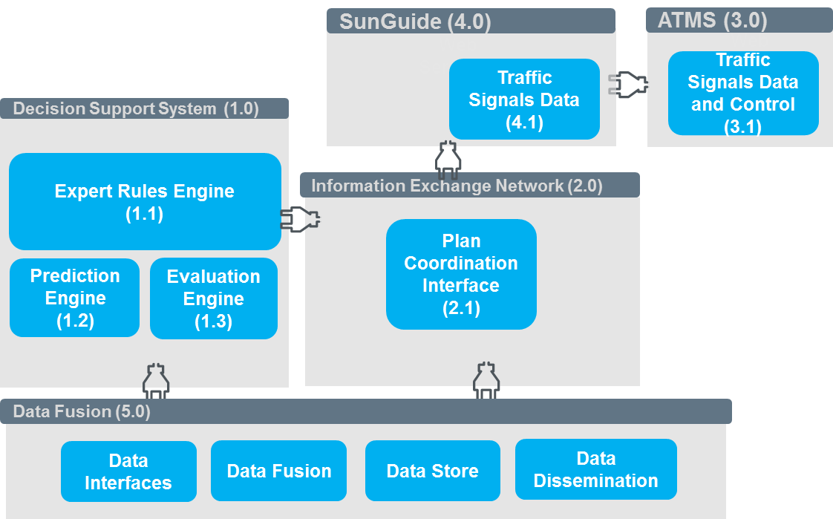
Decision Support System

Slide 11
Approach to ICM
Information Exchange Network
  Stakeholders can view/ edit/ create events and equipment status
  Coordinate Response Plans
Decision Support System
  Expert Rules Engine: Criteria based logic to select a Response Plan Set
  Predictive Model: Select best options within each Response Plan Set and recommend a response plan or do nothing
  Evaluation Model: Offline used to evaluate how response was done, and recommend improvements to plans

Slide 12
DSS Philosophy
Hierarchical DSS
  Level 1 : Local Signalized Intersections
    Deterministic Model to evaluate if a signal and adjacent signals are operating outside of norms
    Send Message to Operator with recommended changes
  Level 2 : Regional ICM Response
    Event Based Rules Engine select initial Plan Set (Location of Event, Severity, Time of Day)
    Predictive Model will evaluate Plan Set to determine best options (Signal Plans, DMS Messaging, Transit Impacts) vs. a “Do Nothing” approach
    Through IEN will notify stakeholders of changes
Level 2 Response Plans will overrule Level 1 changes

Slide 13
DSS Process

Slide 14
Development / Procurement
Active Arterial Management
  Utilize existing City and County vendor traffic signal software
  Procure a central multi-vendor traffic signal software for smaller municipal systems and FDOT to operate (TBD)
Decision Support System
  Invitation to Negotiate for design/ build/ O&M for a works for hire software development
  Procure Mesoscopic Modeling Platform
Data Fusion System
  Invitation to Negotiate for design/ build/ O&M for a works for hire software development
  Utilize Data Warehousing and Data Analytics Tool sets

Slide 15
Thank You
Dr. Kevin T. Miller, PE, PMP
ICM Practice Lead
Kapsch TrafficCom Transportation kevin.miller@kapsch.net

